Slide 1
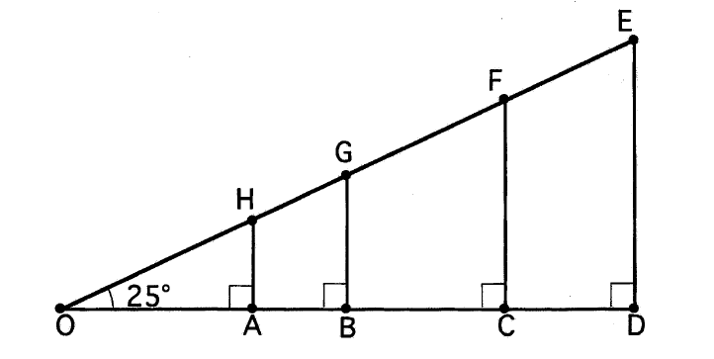
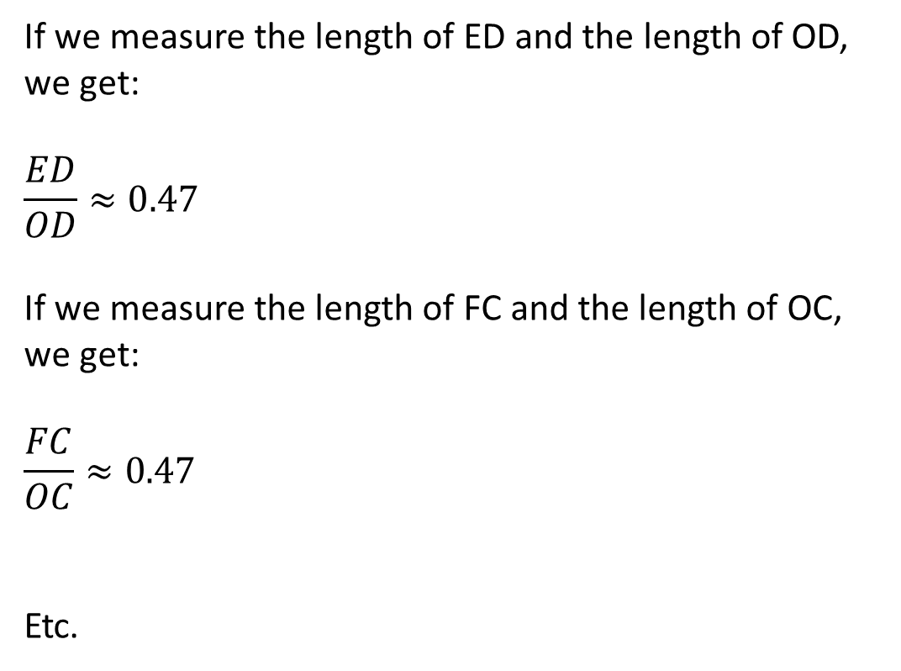
Right angled triangles
The four triangles all have a common angle of 25 degrees, a right angle and therefore a matching angle of 65 degrees each. Each triangle is an enlargement or a reduction of all the other triangles. We know that this means the triangles are similar.
If we measure the length of ED and the length of OD, we get:
$$\frac{ED}{OD}≈0.47$$
If we measure the length of FC and the length of OC, we get:
$$\frac{FC}{OC}≈0.47$$
Etc.

Slide 2
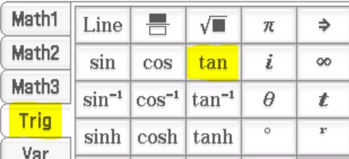
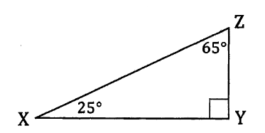

Right angled triangles
For any right-angled triangle we can draw with angles of 25°, 90° and 65°, the side opposite the 25° angle divided by the side in between the 25° angle and the right angle will always give an approximate value of 0.47.
We call this ratio the tangent of 25°, or tan 25°.
For any set of similar right-angled triangles we draw, the same two sides would provide a common ratio (the tangent of the angle).

Slide 3
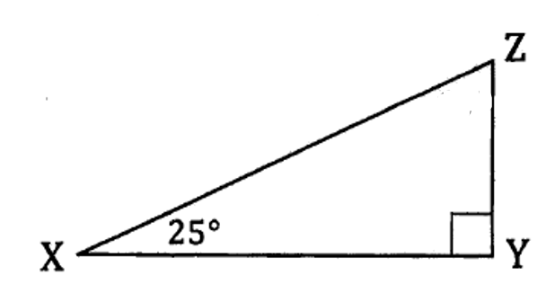
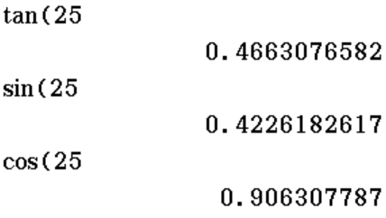
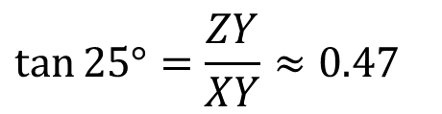
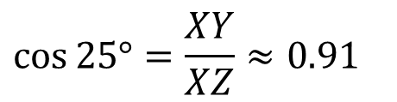
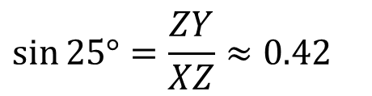
Trigonometry
The tangent of an angle is one of three ratios commonly used in trigonometry.
The three ratios are sine (sin), cosine (cos) and tangent (tan).
$$\tan{25°}=\frac{ZY}{XY}≈0.47$$
$$\sin{25°}=\frac{ZY}{XZ}≈0.42$$
$$\cos{25°}=\frac{XY}{XZ}≈0.91$$

Slide 4
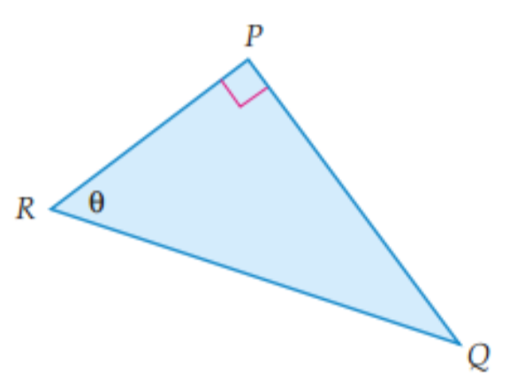


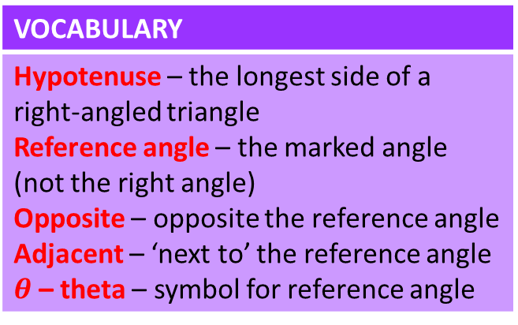

Hypotenuse, opposite and adjacent
VOCABULARY
Hypotenuse – the longest side of a right-angled triangle Reference angle – the marked angle (not the right angle) Opposite – opposite the reference angle Adjacent – ‘next to’ the reference angle $θ$ – theta – symbol for reference angle
In a right-angled triangle, the longest side is ALWAYS opposite the right angle. It has a special name, the hypotenuse.
The other two sides in a right-angled triangle are called the opposite and the adjacent. To tell which one is which, you need to have a reference angle (not the right angle).
adjacent
The right angle is $<RPQ.$
The reference angle ( $θ$ ) is $<PRQ.$
opposite
The hypotenuse is side $RQ.$
The opposite is side $PQ.$
hypotenuse
The adjacent is side $PR.$

Slide 5
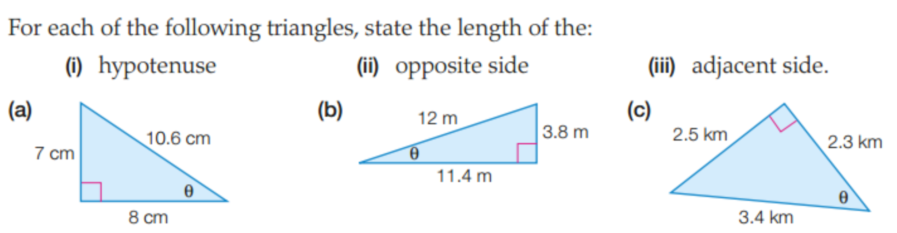
Hypotenuse, opposite and adjacent
VOCABULARY
Hypotenuse – the longest side of a right-angled triangle Reference angle – the marked angle (not the right angle) Opposite – opposite the reference angle Adjacent – ‘next to’ the reference angle $θ$ – theta – symbol for reference angle
Hypotenuse: 10.6 cm
Opposite: 7 cm
Adjacent: 8 cm
Hypotenuse: 12 m
Opposite: 3.8 m
Adjacent: 11.4 m
Hypotenuse: 3.4 km
Opposite: 2.5 km
Adjacent: 2.3 km

Slide 6
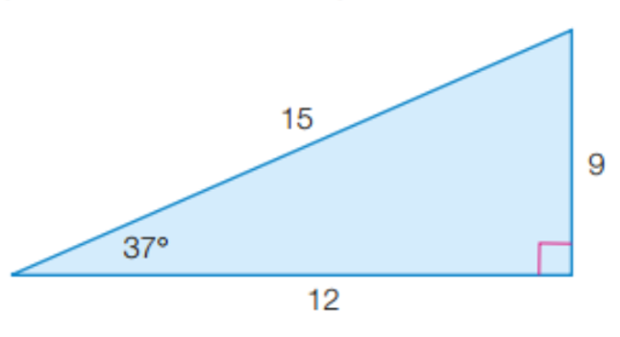
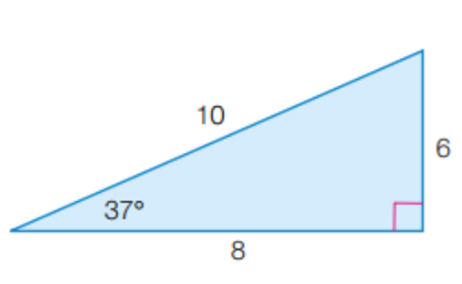
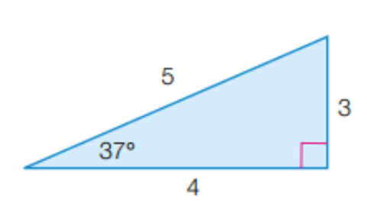
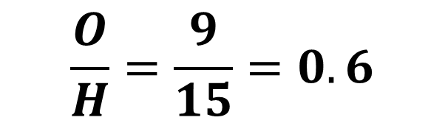
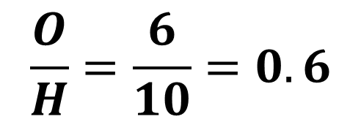
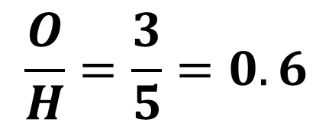

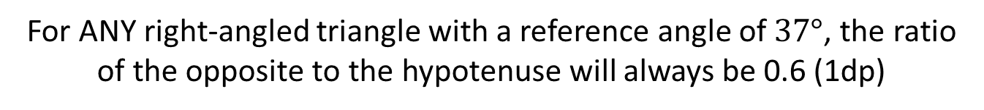
Hypotenuse, opposite and adjacent
All triangles with three angles the same are similar (same shape, different size).
In similar triangles, the ratio BETWEEN sides is also the same.
$$\frac{O}{H}=\frac{3}{5}=0.6$$
$$\frac{O}{H}=\frac{6}{10}=0.6$$
$$\frac{O}{H}=\frac{9}{15}=0.6$$
$$\frac{opposite}{hypotenuse}$$
For ANY right-angled triangle with a reference angle of $37°$, the ratio of the opposite to the hypotenuse will always be 0.6 (1dp)

Slide 7
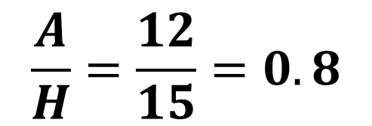
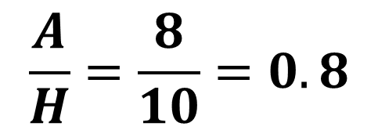
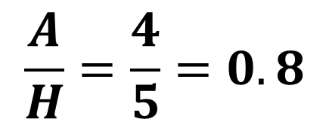

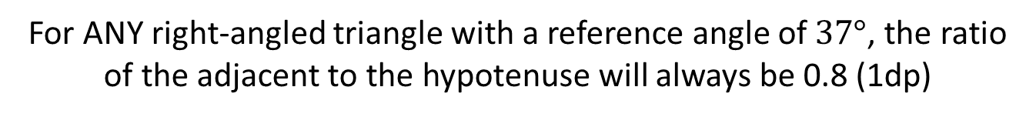
Hypotenuse, opposite and adjacent
All triangles with three angles the same are similar (same shape, different size).
In similar triangles, the ratio BETWEEN sides is also the same.
$$\frac{A}{H}=\frac{4}{5}=0.8$$
$$\frac{A}{H}=\frac{8}{10}=0.8$$
$$\frac{A}{H}=\frac{12}{15}=0.8$$
$$\frac{adjacent}{hypotenuse}$$
For ANY right-angled triangle with a reference angle of $37°$, the ratio of the adjacent to the hypotenuse will always be 0.8 (1dp)

Slide 8
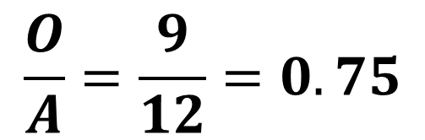
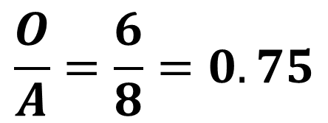
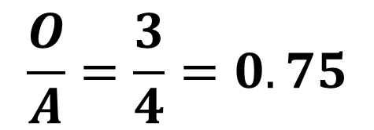
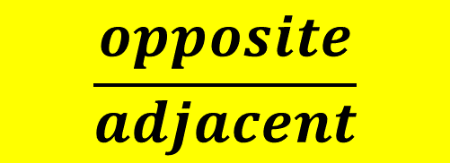
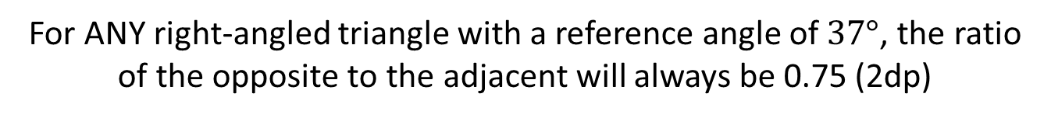
Hypotenuse, opposite and adjacent
All triangles with three angles the same are similar (same shape, different size).
In similar triangles, the ratio BETWEEN sides is also the same.
$$\frac{O}{A}=\frac{3}{4}=0.75$$
$$\frac{O}{A}=\frac{6}{8}=0.75$$
$$\frac{O}{A}=\frac{9}{12}=0.75$$
$$\frac{opposite}{adjacent}$$
For ANY right-angled triangle with a reference angle of $37°$, the ratio of the opposite to the adjacent will always be 0.75 (2dp)

Slide 9



Hypotenuse, opposite and adjacent
All triangles with three angles the same are similar (same shape, different size).
In similar triangles, the ratio BETWEEN sides is also the same.
We have been looking at three ratios in particular. These three ratios are very important in trigonometry and are called trigonometric ratios.
$$Sin θ= \frac{O}{H}$$
The ratio for $\frac{opposite}{hypotenuse}$is called sine (sin on your calculator).
S O H
$$Cos θ= \frac{A}{H}$$
The ratio for $\frac{adjacent}{hypotenuse}$is called cosine (cos on your calculator).
C A H
$$Tan θ= \frac{O}{A}$$
The ratio for $\frac{opposite}{adjacent}$is called tangent (tan on your calculator).
T O A
SOH CAH TOA is an easy way to remember which ratio contains which sides.

Slide 10
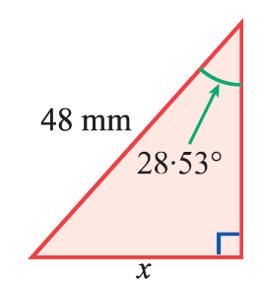
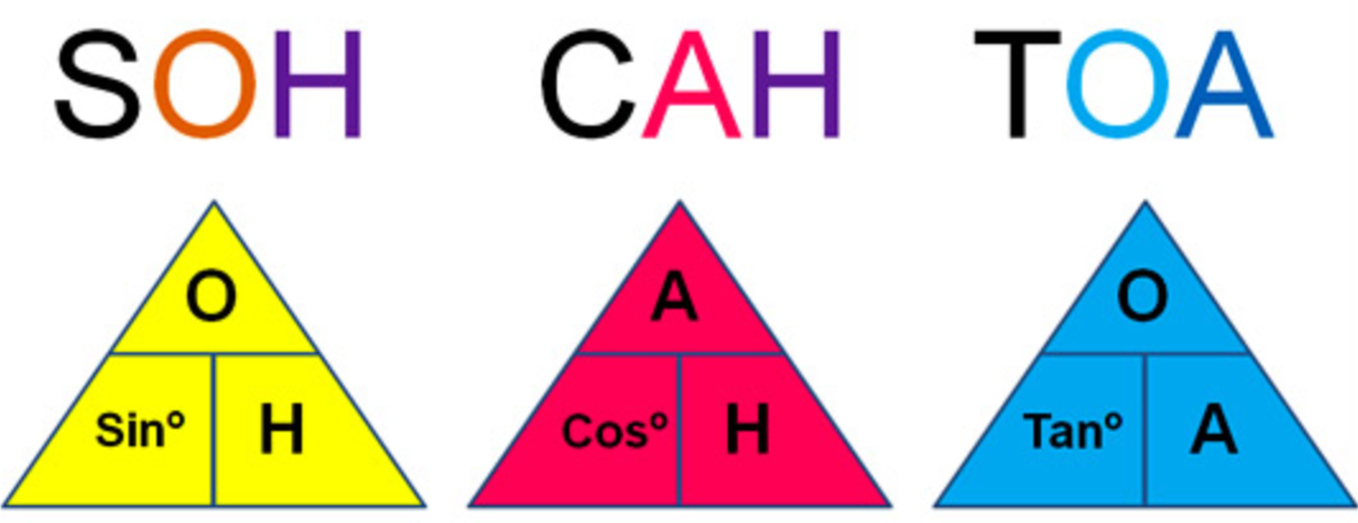
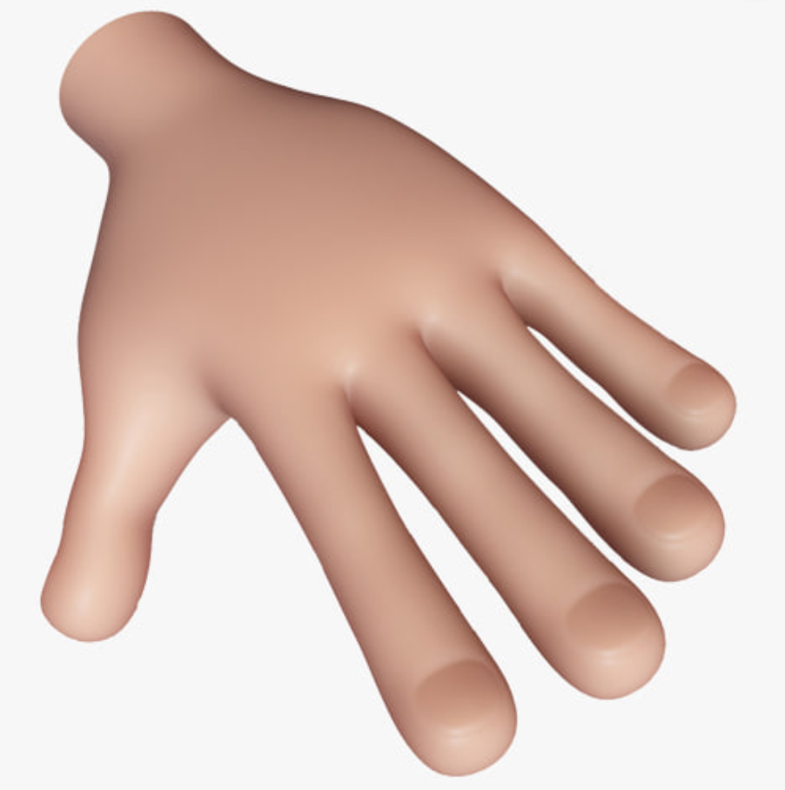
Examples
Step 1: Label your triangle.
Step 2: Decide the ratio you need.
Step 3: Substitute in the values.
Step 4: Solve the equation.
We want to find the opposite. We know the hypotenuse.
S O H
$$Sin θ= \frac{O}{H}$$
$$Sin 28.53°= \frac{x}{48}$$
$$48×Sin 28.53°=x$$
$$×$$
Cover up the side you want to find.
$$x=22.93 mm (2dp)$$

Slide 11
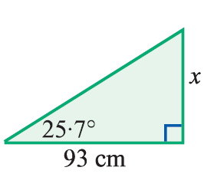
Examples
Step 1: Label your triangle.
Step 2: Decide the ratio you need.
Step 3: Substitute in the values.
Step 4: Solve the equation.
We want to find the opposite. We know the adjacent.
$$Tan θ= \frac{O}{A}$$
T O A
$$Tan 25.7°= \frac{x}{93}$$
$$93×Tan 25.7°=x$$
$$×$$
Cover up the side you want to find.
$$x=44.76 cm (2dp)$$

Slide 12
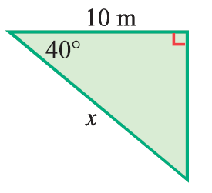
Examples
Step 1: Label your triangle.
Step 2: Decide the ratio you need.
Step 3: Substitute in the values.
Step 4: Solve the equation.
We want to find the hypotenuse. We know the adjacent.
C A H
$$Cos θ= \frac{A}{H}$$
$$Cos 40°= \frac{10}{x}$$
$$÷$$
$$x=\frac{10}{Cos 40°}$$
Cover up the side you want to find.
$$x=13.05m (2dp)$$

Slide 13
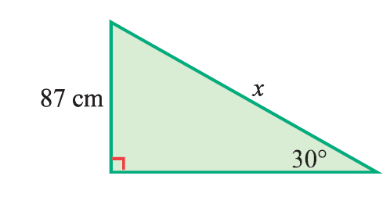
Examples
Step 1: Label your triangle.
Step 2: Decide the ratio you need.
Step 3: Substitute in the values.
Step 4: Solve the equation.
We want to find the hypotenuse. We know the opposite.
S O H
$$Sin θ= \frac{O}{H}$$
$$Sin 30°= \frac{87}{x}$$
$$÷$$
$$x=\frac{87}{Sin 30°}$$
Cover up the side you want to find.
$$x=174m$$

Slide 14
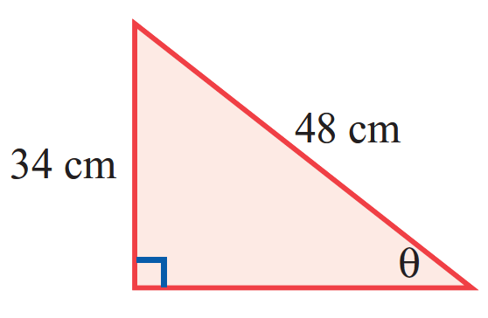





Examples
Step 1: Label your triangle.
Step 2: Decide the ratio you need.
Step 3: Substitute in the values.
Step 4: Solve the equation.
We know the opposite and the hypotenuse.
S O H
$$Sin θ= \frac{O}{H}$$
$$Sin θ=\frac{34}{48}$$
If you’re trying to find an angle, use the inverse function to solve.
$${Sin}^{−1}\left(\frac{34}{48}\right)=θ$$
$$θ=45.10° (2dp)$$

Slide 15
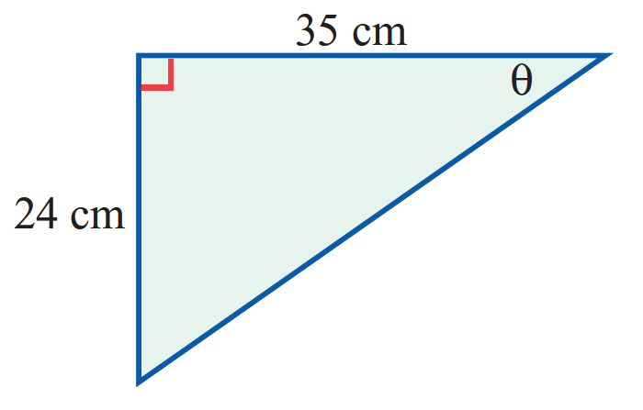





Examples
Step 1: Label your triangle.
Step 2: Decide the ratio you need.
Step 3: Substitute in the values.
Step 4: Solve the equation.
We know the opposite and the adjacent.
T O A
$$Tan θ= \frac{O}{A}$$
$$Tan θ=\frac{24}{35}$$
If you’re trying to find an angle, use the inverse function to solve.
$${Tan}^{−1}\left(\frac{24}{35}\right)=θ$$
$$θ=34.44° (2dp)$$

Slide 16
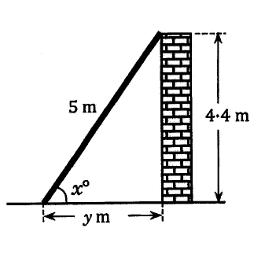
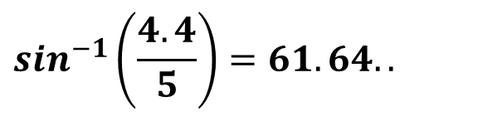
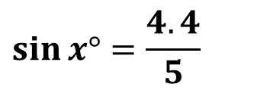



Worded problems
Now do exercise 10A
Some questions will be more applicable to real life problems, and will refer to a particular situation involving a right angled triangle.
We may need to draw a simple diagram to represent the situation.
We may also need to use a combination of trigonometry and Pythagoras’ theorem.
A ladder of length 5 metres leans against a vertical wall. If the top of the ladder reaches 4.4m up the wall, calculate the angle the ladder makes with the horizontal ground and the distance from the foot of the ladder to the wall.
$$\sin{x°}=\frac{4.4}{5}$$
$$y^{2}+{4.4}^{2}=5^{2}$$
$$\sin^{−1}\left(\frac{4.4}{5}\right)=61.64..$$
$$y^{2}=5^{2}−{4.4}^{2}$$
$$x≈62°$$
$$y≈2.375$$
Worded question? Worded answer!
The ladder makes an angle of 62° with the ground and is 2.4m away from the wall.

